Slide 1
Sustained Earnings and Revenue Growth, Earnings Quality, and Earnings Response Coefficients
---- ALOKE GHOST, ZHAOYANG GU, PREM C JAIN*
Presenter: Xiaoyue Liang

Slide 2
Outline
Research Objective
Hypothesize
Research Design
Sample and Descriptive Statistics
Results
Conclusions

Slide 3
--Research Objective
Explore the effects of sustained increases in earning concurrent with sustained increase in revenue on the quality of earnings and earnings response coefficients (ERCs)
Notes:
Prior research demonstrates that firms with sustained increases

Slide 4
--Hypotheses
For firms that report sustained increases in earnings along with sustained increases in revenues:
Earnings are of higher quality
ERCs are larger in comparison with the earnings of firms that show sustained increases in earnings but not in revenues

Slide 5
Hypotheses Development
Revenues
Earning
Expenses
Notes:
Prior research has shown that firms with sustained increases in earnings have higher ERCs than other firms. However, there are two major components of earnings: Revenues and expenses. Sustained increase in earnings can be achieved through different components in earning. So there are two broad strategies to achieve sustained increases in earning.

Slide 6
Hypotheses Development
Revenue-Increasing Strategy
Revenues
Earning
Expenses
Notes:
Prior research has shown that firms with sustained increases in earnings have higher ERCs than other firms. However, there are two major components of earnings: Revenues and expenses. Sustained increase in earnings can be achieved through different components in earning. So there are to broad strategies to achieve sustained increases in earning.

Slide 7
Hypotheses Development
Revenue-Increasing Strategy
Revenues
Earning
Cost-Cutting Strategy
Expenses
Notes:
It would be relatively easy for competitors to emulate cost-cutting strategy, however Revenue-increasing strategy is supposed to be better strategy. Because revenue increases have unlimited potential, cost reduction have a lower bound; Difficult to maintain continuous cost reduction. Also it’s more like a short-term remedy than long-run solution and might hurt the profit in the long run.

Slide 8
Earnings Management
Managing Revenue Growth
Difficult;
GAAP violations;
Require external party’s cooperation;
subject to stringent scrutiny by auditors and SEC
Managing Cost Reductions
Within GAAP
Managers have more flexibility in the timing of the reversal of the cost-related accruals
Notes:
Earning growth can also be achieved through earnings management
Techniques: Inventory stuffing, bill and hold and early buy-back

Slide 9
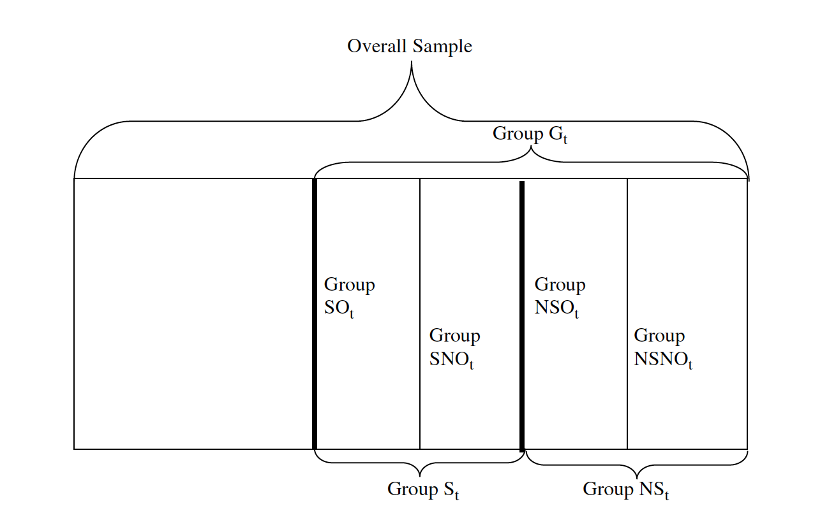
--Research Design
Grouping of Firms with Sustained Earnings Growth
Notes:
For fiscal year t, Group Gt is composed of firms with five consecutive years of earning per share increases up to year t. Within Group G, Group S, which represents sales or revenues, consists of firms with five years of consecutive revenue per share increases up to year t. The remaining firms in group G are classified as group NS (not sales). So NS are considered as cost-reduction firms because they must have experienced one or more years of sales decreases over the five prior years.
To separately consider the effect of operating and non-operating items on earning quality, we form SO (sales and operating) for those firms in group S that had five years of operating earning per share increase up to year t.
SNO(sales but not operating earning)
Similarly, in group NS, we have NSO (not sales but operating earnings)
NSNO(not sales and not operating earning)
SNO, NSNO, the have to reduce non-operating costs or recognizing non-operating gains to maintain earning increases,lower quality, be dominated by SO and SNO

Slide 10
Test on Earnings Quality
Earning Management
Examine total accruals, working capital accruals, abnormal accruals, special items and share repurchase
Future Operating
Examine analysts’ long-term earnings growth forecasts, realized future return on assets, and the frequency of firms that continue to have earning increases
Earning Persistence
Specific Models (Freeman et al. (1982)
Notes:
Model will be show in the following powerpoint

Slide 11
Examine the Persistence of Earnings Levels
E : earnings per share,
E-/E+ : negative and non-negative measures of E (losses and profits)
P : stock price at the end of the third month after the fiscal year-end
D : dummy variables for firms in groups S, NS, SO, SNO, NSO or NSNO
Notes:
1a: examines the two broad groups S and NS
1b: examines the finer groups SO, SNO, NSO, NSNO
Allow different persistence parameters on profits and losses because losses are likely to be more transitory due to abandonment option

Slide 12
Examines the Persistence of Earnings Growth
$∆:$First-difference operator
$∆E^{+} and ∆E^{−}$: Positive and negative earnings changes
Notes:
Earning changes are on average negatively serially correlated, earnings process is mean reverting
We expect earning growth is less likely to reverse when it is sustained through revenue increases
Since earnings growth by definition is a position earning change, the various groups we examine are strictly subsets of firms with delta E plus

Slide 13
Model (1)&(2)
b1, b2 : Capture the earnings persistence of negative and positive earnings /earnings changes for average firms without sustained earnings growth
For Models (1a) and (2a), we expect $b3>b4>0$
For Models (1b) and (2b), we expect
$b31>b41>0$ $b41>b42>0$revenue supported dominate
$b31>b32>0$ $b41>b42>0$ Sustained operating earning dominate
Notes:
B3>b4>0: the incremental persistence parameters are higher when earnings growth is sustained through revenue increases
First line: within firms with sustained operating earnings increase (SO, NSO),and those without (SNO,NSNO), the incremental earnings persistence parameters are higher when firms
Have revenue-supported earning growth
Second: Those with sustained operating earning growth dominate those without

Slide 14
Tests on Earnings Response Coefficients
Ohlson(1995) Model: Higher weight on earnings corresponds to a lower weight on book value
Relative weight on book value is low (high) when earnings levels are high(low)
Based on price levels models (3a) (3b):
BV: book value per share. DE+ and DE- : Dummy Variables for E<0 and E>0
Notes:
Separate earnings and earnings changes into positive and negative measures to consistent with the previous persistence tests
Measure stock prices Pt three months after the end of fiscal year t to ensure that accounting information is available to the market
For valuation purpose

Slide 15
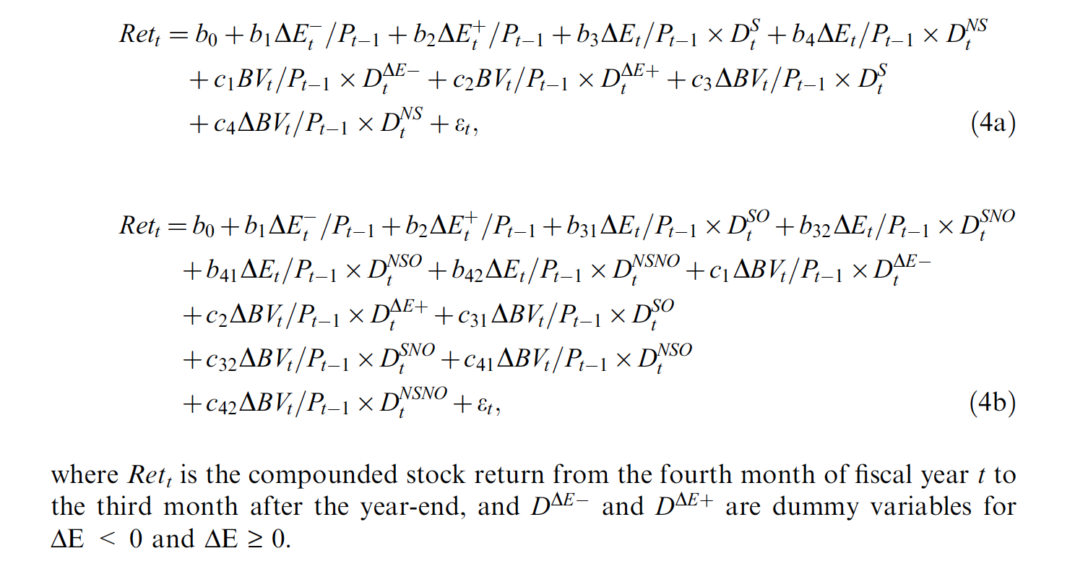
Returns Model (4a) (4b)
Notes:
We use both the price levels models and the returns models because together they
provide a complimentary set of results (Barth et al., 2001; Gu, 2005). The coefficients
of the two models often differ significantly (Kothari and Zimmerman, 1995) and
hence the returns models need not merely be the first-differenced versions of the
(deflated) levels models. Thus, it is important to verify the results from the levels
models by using the returns models. In addition, while valuation takes a measurement
perspective, the returns models can also be justified from an information
perspective. If DE is considered as a proxy for earnings surprises, then the returns
models are the traditional long-window earnings-returns relations measuring the
informativeness of earnings.

Slide 16
For Models (3a) and (4a), we expect $b3>b4>0$
For Models (1b) and (2b), we expect
$b31>b41>0$ $b41>b42>0$revenue supported dominate
$b31>b32>0$ $b41>b42>0$ Sustained operating earning dominate
We expect lower book value response coefficients (BVRCs)
Notes:
ERCs are higher when earning growth is sustained through revenue increases than cost reductions
For the groups with sustained operating earnings increases and the groups without these increases, ERC high revenue growth
Within revenue increase and non-revenue increase group, ERCs are higher when operating earnings increases as sustained
IN contract, we expect

Slide 17
-- Sample Selection
Initial sample: all firms covered on Compustat, active and inactive, from 1980 to 2000
Strings of variables are calculated starting from 1975
A firm is included only if it has at least five consecutive years of accounting data
To mitigate the potential effect of outliers, we remove the top and bottom 1% of observations for stock prices, book value and earnings.
In the returns models, 1% of the extreme observations corresponding to returns, deflated book value changes and earnings changes are also removed.
Final Sample: 94,687 Observations for price levels regressions
92,783 for returns regressions
Notes:
String: to ensure that a firm with five or more years of earnings increases has a long enough priorearnings history by 1980.
3rd: This allows the calculation of sustained growth and also
avoids selecting recent IPO firms with high growth potential or high risks that affect
the ERCs

Slide 18
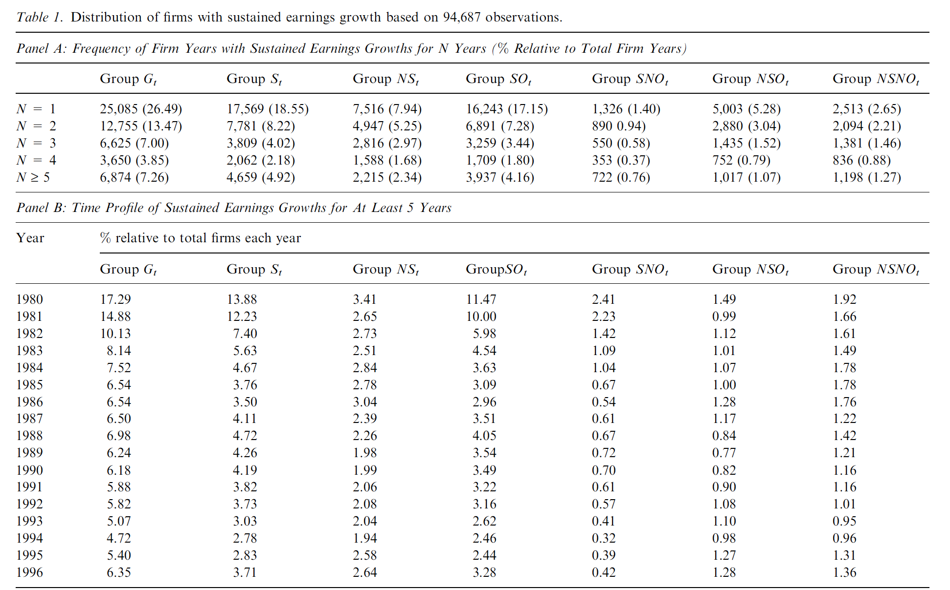
Descriptive Statistics
Notes:
A firm years with sustained earning growth
B time profile of firms with long strings of growth for at least five years. No any evidence that particular groups are concentrated in certain years
The chart does not indicate industry. However, firms with earning increases for at least five years are widely distributed in 66 different industries

Slide 19
Results – Earnings Persistence
Notes:
Model 1a: persistence parameter b1=0.613 for negative and b2 = 0.814 for positive earnings
Incremental persistence parameter b3 = 0.251 for group S and b4 = 0.132 for group NS (highly significant)
1% of current roes is able to predict (0.814+0.251) of future ROE for S and (0.814+0.132) for NS b3-b4=0.119% highly significant
Model 2a: examine Persistence of earnings changes. For firms without sustained earnings growth, b1 = -0.648 for negative changes and b2 = 0.016 for positive changes
B3=0.795 indicates that earnings growth of firms in groups S is followed by smaller subsequent earning decreases and possibility earnings increase
The difference between groups S and NS is highly significant b3-b4 = 0.658
We can see b31>b41, b32>b42; b31>b32 and b41>b42 the difference are significant, results on earnings persistence are consistent with our predictions

Slide 20
Results—Earnings Management and Future Performance
Notes:
All accrual items are higher for group G than overall averages
Both measures are lower for group S than those for group NS, and the difference are large. Group S are less likely to use income-increasing accruals than firms in group NS
Among SO,SNO,NSO,and NSNO, accruals are generally the lowest for group SO and the highest for NSNO
No evidence to suggest that revenue-growth firms achieve earnings growth through more aggressive earnings management
firms with sustained earning growth, on average, have much higher subsequent returns(ROA) and from continuation, are more likely to continue earnings increases in the following year
Group S’s long-term growth forecast are higher by 2.42%, performance are highest for group SO and lowest for group NSNO
LT growth G and overall sample

Slide 21
Results—Earnings Response Coefficients
Notes:
(3a)Here is the main result of ERCs. In price levels model (3a), ERC on positive (b2) is much higher than negative earnings (b1), corresponding BVRCs c2<c1, consistance with
Argument that valuation role of book value is important when earnings are negative
Incremental ERC (b3) for group S is twice as much as b4 for group NS. BVRC for both groups are negative (c3, c4)
Results suggest that as firms’growth becomes more sustainable, the valuation weight on earning becomes larger and the valuation weight on book value becomes smaller or even negative
(3b) all positive, mostly significantly b31 b41 b32…
3,4 are consistant, market valuation is higher for earnings and lower for book value when earning growth is sustained through revenue increases

Slide 22
Results—Earnings Response Coefficients

Slide 23
Conclustion
Consistent with predictions
Earnings are of higher quality for the revenue-growth firms than for cost-reduction firms
Earnings for the revenue-growth firms are more persistent and are less likely to be managed
Revenue-Growth firms have higher future operating performance
The higher ERCs for the revenue-growth firms are accompanied by lower response coefficients on book value
Earning quality and ERCs are the highest when sustained increases in earnings are supported by sustained increase in both revenues and operating earnings

Slide 24
Outlook
Notes:
long term earnings growth forecasts in year t are lower than an average firm, possibly reflecting analysts’ belief of the long-run mean-reverting property of earnings

Slide 25
Outlook
Sustained Earnings Length: 5 year to shorter or longer?
Industry Difference: How industry trend may influence the Sustained earnings and Revenue Growth? e.g. Internet industry nowadays

